Slide 1

Data Structures & Algorithms
Week-13

Slide 2
Week-13 Agenda
  Greedy Algorithm
  Huffman Coding

Slide 3
Greedy Algorithm
A greedy algorithm is an approach for solving a problem by selecting the best option available. It doesn't worry whether the current best result will bring optimal results.
The algorithm never reverses the earlier decision even if the choice is wrong. It works in a top-down approach.
This algorithm may not produce the best result for all the problems. It's because it always goes for the best local choice to produce the global best result.

Slide 4
Greedy Algorithm
A greedy algorithm is an approach for solving a problem by selecting the best option available. It doesn't worry whether the current best result will bring optimal results.
The algorithm never reverses the earlier decision even if the choice is wrong. It works in a top-down approach.
This algorithm may not produce the best result for all the problems. It's because it always goes for the best local choice to produce the global best result.

Slide 5
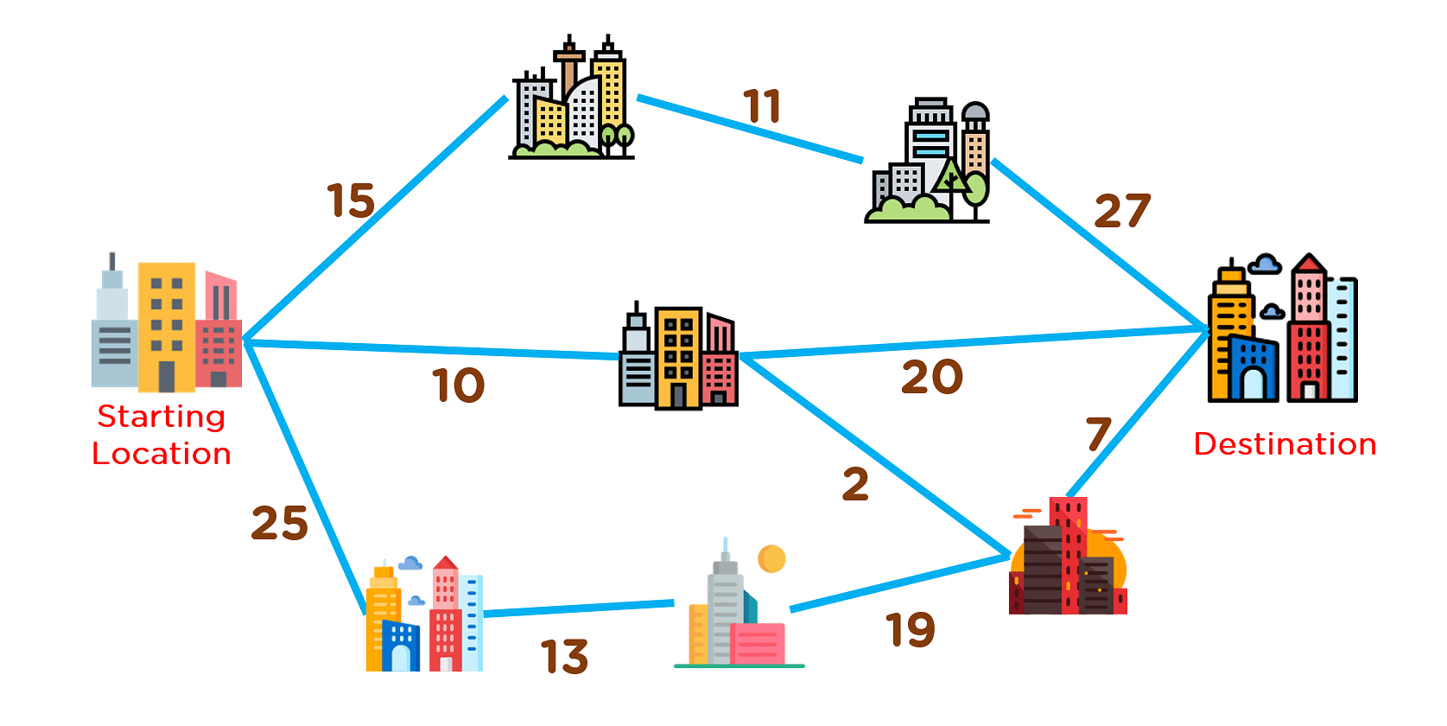
Greedy Algorithm

Slide 6
Huffman Coding
Huffman Coding is a technique of compressing data to reduce its size without losing any of the details. It was first developed by David Huffman.
Huffman Coding is generally useful to compress the data in which there are frequently occurring characters.

Slide 7
Encoding Steps
Frequency Calculation:
  Count the frequency of each character in the input data.
Create a Priority Queue:
  Use the frequencies to create a priority queue (or min-heap) where each node represents a character and its frequency.
Build the Huffman Tree:
  While there is more than one node in the queue:
    Remove the two nodes with the lowest frequencies.
    Create a new internal node with these two nodes as children and a frequency equal to the sum of their frequencies.
    Insert the new node back into the queue.
  The remaining node is the root of the Huffman tree.

Slide 8
Encoding Steps
Generate Codes:
  Traverse the Huffman tree to assign codes to each character:
    Assign a '0' for a left branch and a '1' for a right branch.
    The path from the root to a character gives its binary code.
Encode the Input Data:
  Replace each character in the input data with its corresponding Huffman code to generate the encoded output.

Slide 9
Decoding Steps
Use the Huffman Tree:
  Start with the root of the Huffman tree.
Read the Encoded Data:
  Read the encoded binary data bit by bit.
  Move down the tree based on the bits:
    Go left for '0' and right for '1'.
Identify Characters:
  When a leaf node is reached, record the character.
  Return to the root of the tree and continue reading the next bits.
Repeat Until Complete:
  Repeat the process until all the encoded data is decoded back into the original data.

Slide 10

Encoding Example
How Huffman Coding works?
Suppose the string below is to be sent over a network.
Each character occupies 8 bits. There are a total of 15 characters in the above string. Thus, a total of 8 * 15 = 120 bits are required to send this string.
Using the Huffman Coding technique, we can compress the string to a smaller size.
Huffman coding first creates a tree using the frequencies of the character and then generates code for each character.

Slide 11
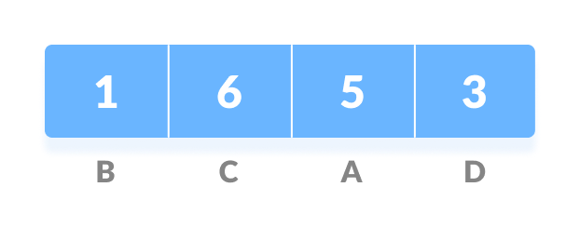
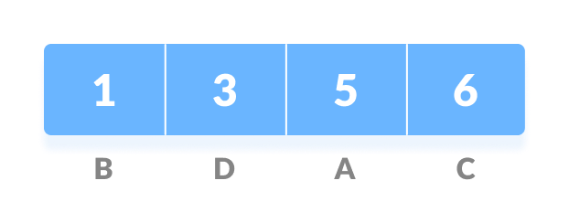
Encoding Example
Huffman coding is done with the help of the following steps.
Calculate the frequency of each character in the string.
Sort the characters in increasing order of the frequency. These are stored in a priority queue Q.

Slide 12
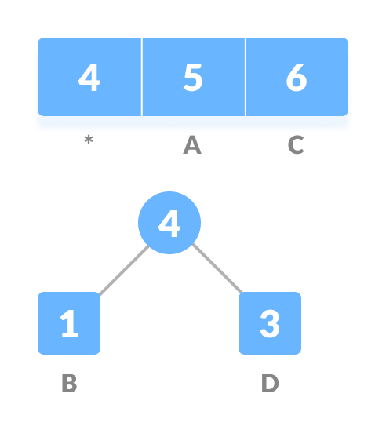
Encoding Example
Make each unique character as a leaf node.
Create an empty node z. Assign the minimum frequency to the left child of z and assign the second minimum frequency to the right child of z. Set the value of the z as the sum of the above two minimum frequencies.

Slide 13
Encoding Example
Remove these two minimum frequencies from Q and add the sum to the list of frequencies (* denote the internal nodes in the figure above).
Insert node z into the tree.

Slide 14
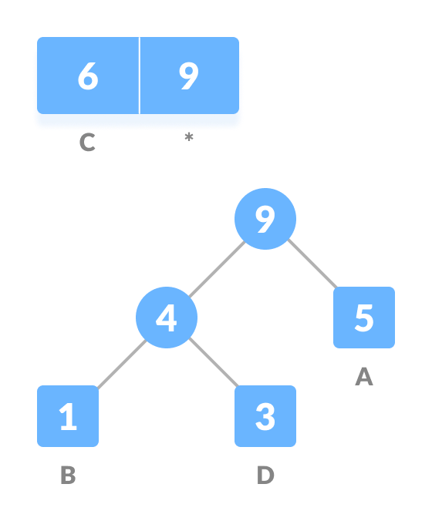
Encoding Example
Repeat steps 3 to 5 for all the characters.

Slide 15
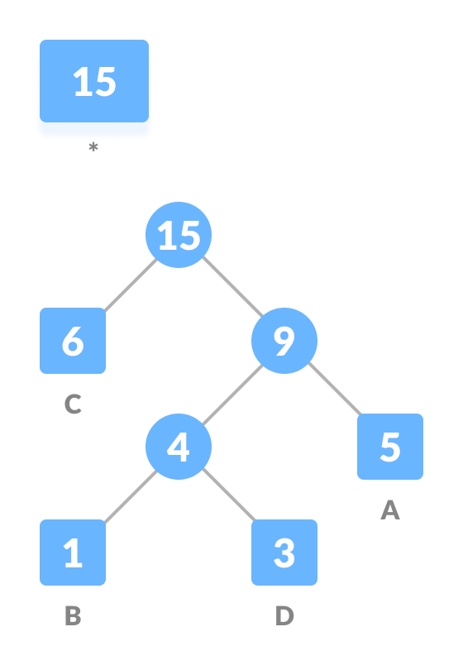
Encoding Example
Repeat steps 3 to 5 for all the characters.

Slide 16
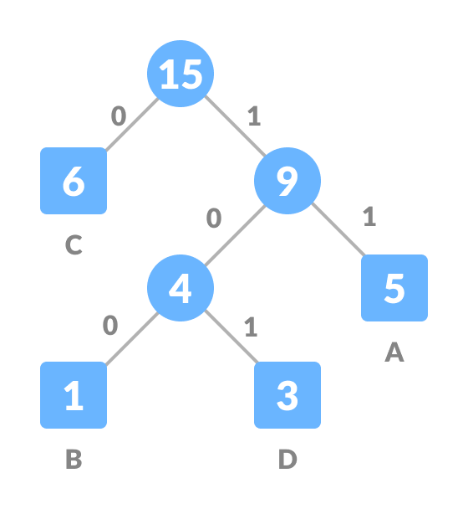
Encoding Example
For each non-leaf node, assign 0 to the left edge and 1 to the right edge.

Slide 17
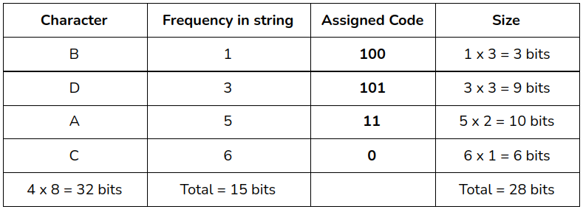
Encoding Example
For sending the above string over a network, we have to send the tree as well as the above compressed-code. The total size is given by the table below.
Without encoding, the total size of the string was 120 bits. After encoding the size is reduced to 32 + 15 + 28 = 75.

Slide 18

Decoding Example
Decoding the code
For decoding the code, we can take the code and traverse through the tree to find the character.
Let 101 is to be decoded, we can traverse from the root as in the figure below.

Slide 19
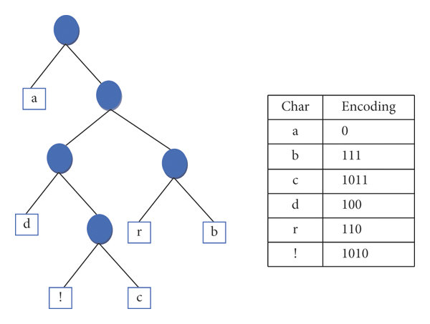
Another Example

Slide 20
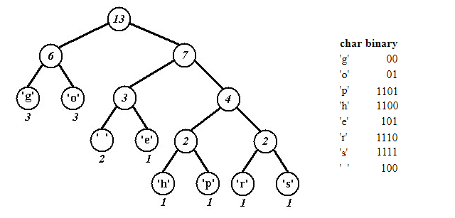
Another Example

Slide 21


